Slide 1

SMART CITIES THROUGH IOT AND ANALYSIS INFERENCE
JUSCO
KUMAR ABHINAV
kabhinav569@gmail.com
91-8089 606 696
quality services for life

Slide 2

CONTENTS
LoRaWAN
JAMSHEDPUR as SMART city
Implementation of SENSORS in city
TREND ANALYSIS of SENSORS data
Reviewing of WCCD data for cities
INVESTIGATION IMPACTS

Slide 3
LPWAN - IOT
low power wide area network (LPWAN) is a wireless communication network for internet of things .
features of LPWAN
Low Power : The rate of data is usually around a few hundred or less. The rate depends on applications. Owing to the low power consumption, the lifespan of the battery is more than 10 years.
High Penetration : The penetration power of LPWAN gateways is quite amazing as it can penetrate deep into the ground as well as inside building – thus it is able to connect to sensors anywhere outside,inside or underground.
Low Cost : Several hundreds and thousands of devices are served by Base Stations – thus requiring less base stations and low infrastructure cost.
High Sensitivity : Its unique ability of filtering out constant ramp chirp signal while delivering long-distance data helps achieve high-interference immunity.
Long Range : The range is quite long (5 – 15 Km) depending on the environment – owing to which it provides better coverage both in urban and rural areas.
Low Data Rate : The data transfer rate is quite low (less than 5000 bits per second). Therefore, only 25 – 256 bytes per message are sent several times a day.

Slide 4
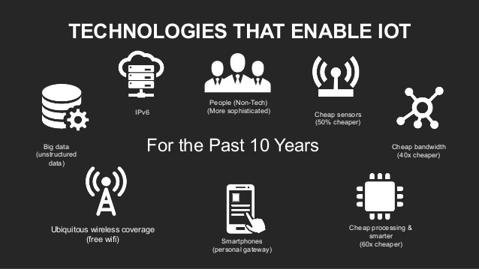

Slide 5
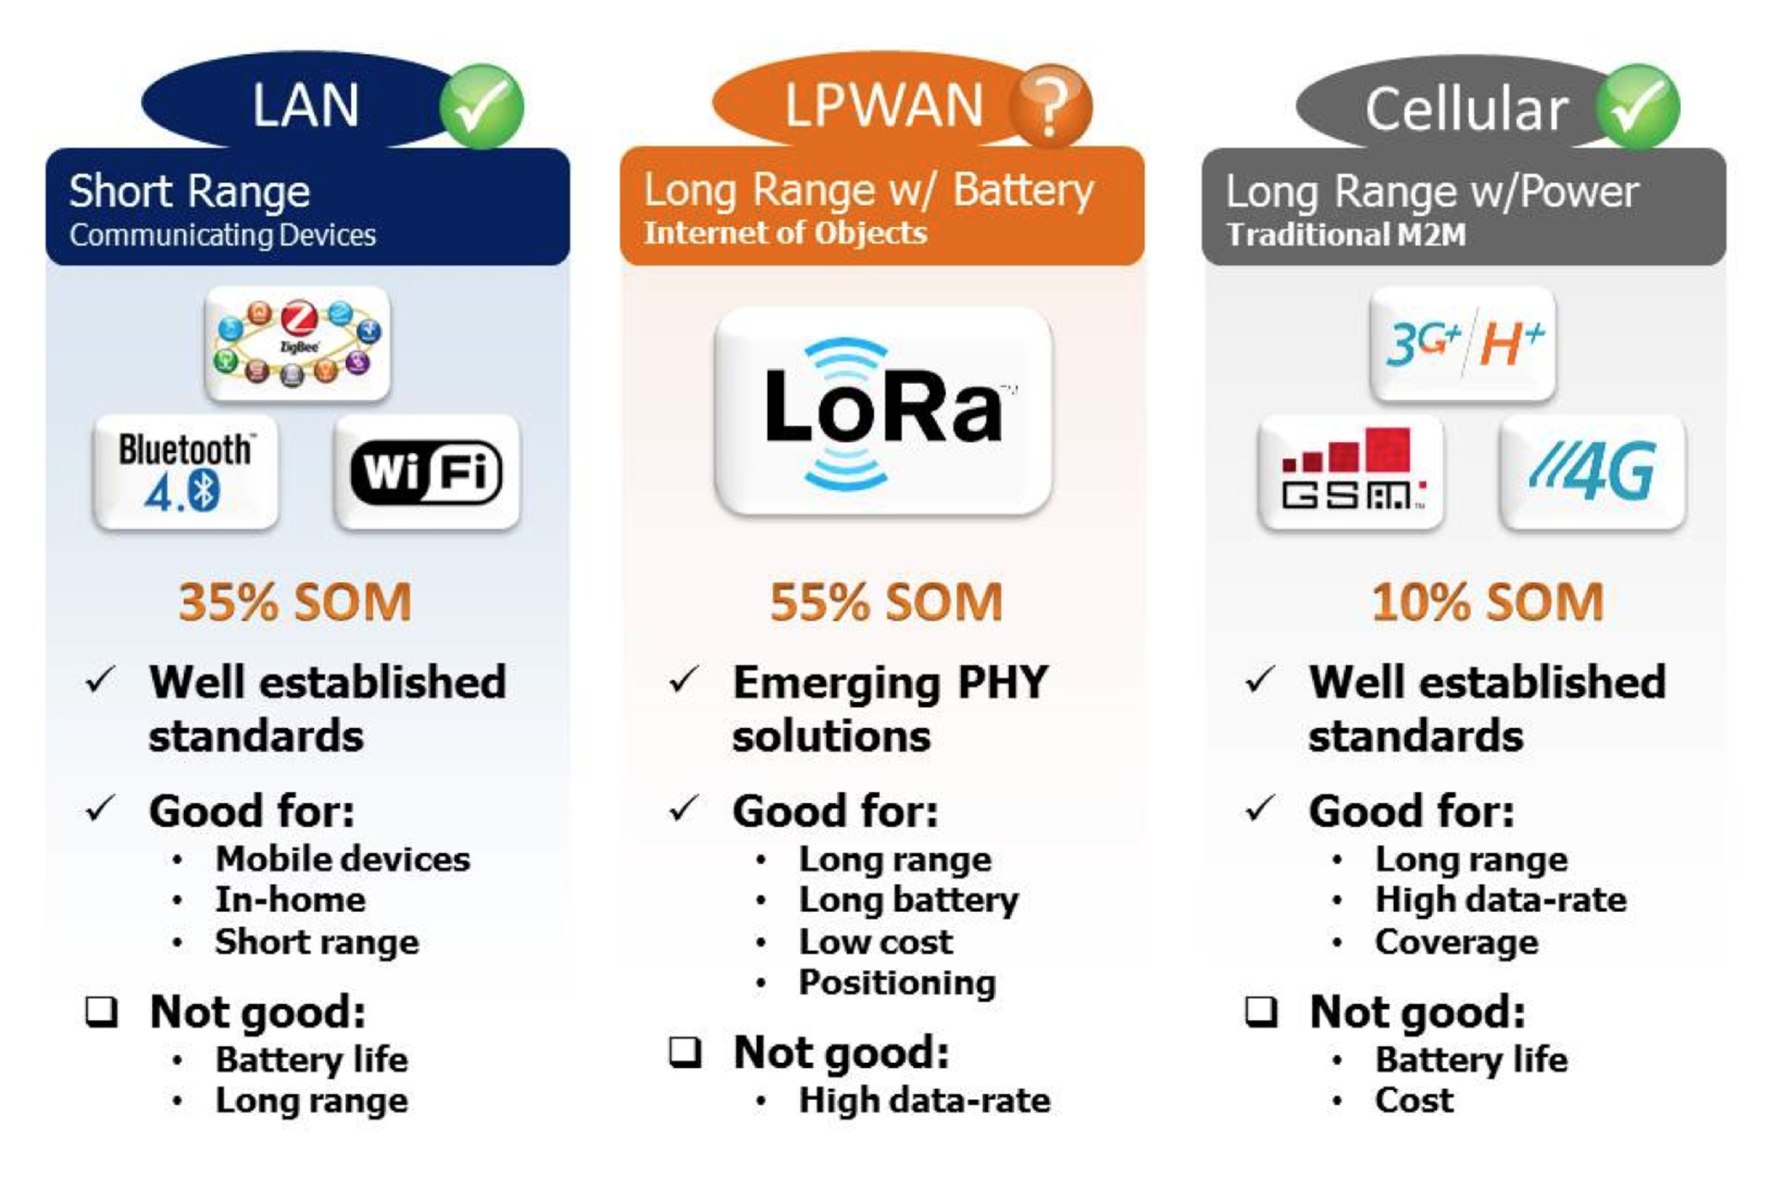
WHY LPWAN /LoRaWAN ?

Slide 6
JAMSHEDPUR AS A SMART CITY
FACTORS IN FAVOUR OF JAMSHEDPUR
In a 2013 study of AC Nielsen ORG-Marg, Jamshedpur is named the second-best city in quality of living in India. Primary reasons for this rating were reliable electricity, water supply and sewage systems. In International Global Water Wards 2008, Utilities and Services Company Ltd was ranked the best provider of water in India. In this town build for employees of Tata, the company owned tracts of land that are large enough that they could plan infrastructure.
George Mason University professor Alex Tabarrok points out that despite being privately run, water, sewage and electricity provisions in Gurgaon are not efficient. Unlike , private providers of these sources do not own enough land. So, they do not have enough incentives to plan infrastructure that would benefit the whole city. To attract the best employees possible, Tata Steel had to invest in civic infrastructure in Jamshedpur.
By allowing private developers and companies to buy land easily, the government can ensure a better infrastructure. If land acquisition laws were easy throughout the country, we would have seen more cities like Jamshedpur. Tatas founded Jamshedpur in 1908, when it was easier to acquire land. Acquiring land is not easy anymore.

Slide 7
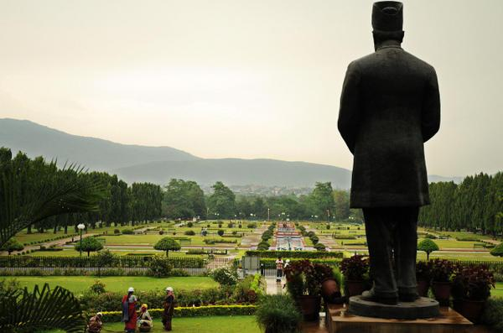
NEWSPAPER CLIPPING
"We will be using LoRAWAN (Lower Power Wide Area Network), new data network technology, to allow connectivity with the Internet without using 3G or WiFi. It is ideal for battery-operated sensors and low-power applications in customised sensors so that real-time information can be sent to the integrated command centre," explained Jusco's senior deputy general manager, corporate relations and corporate communications, A.P. Singh.
The command centre, to come up at Jusco corporate office, will display real-time data of all the basic civic services ie, water, electricity, parking lots and roads, Jusco provides for a population of 8 lakh.
According to a Jusco official in the urban planning department, sensors using LoRAWAN technology would be fitted at the water treatment plant (WTPs) and also at water towers in the first phase. These sensors will not only inform the command centre about a dip in water pressure, indicating leaks, but also alert the centre about water levels at towers to prevent wastage, in addition to monitoring the water quality being supplied.
"Gradually, we will be fitting such sensors with water meters in individual households to detect wastage due to leakage or overflow in the supply line and also monitor the quality of water being supplied," said Singh, adding that sensors would also be fitted at power sub-stations and transformers to detect overloading and prevent outages.

Slide 8
IMPLEMENTATION OF SENSORS
SMART BINS
Protects environmental health and promotes quality of urban environment with the real-time location and monitoring of waste containers
Notifies the fill level of the containers all the time and empties the container only when detected full
Maximizes waste recycling and reuse
Helps in data analytics and planning with centralized data collection
Reduces service cost by 50% by efficient monitoring and management of waste bins
Provides centralized dashboard and command control centre for waste collection and transportation
Helps in real time monitoring of the vehicles to improve the productivity and reduce non-compliance
Helps in efficient usage and route optimization of garbage trucks
Reduces fuel consumption by avoiding unnecessary roundtrip of trucks
Sends SMS to the driver to notify them about when the bin is going to be filled
Offers 24/7 live bin level monitoring

Slide 9
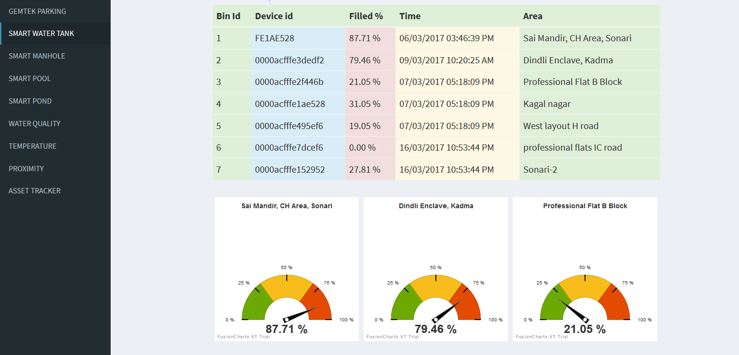
sample data of SMART BIN

Slide 10
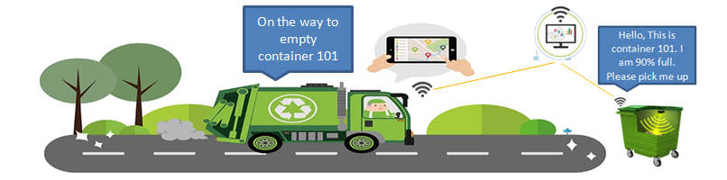
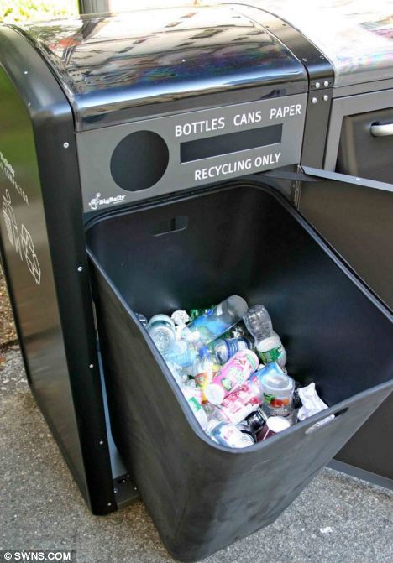
IMPLEMENTATION OF SMART BINS
SEGREGATION OF WASTE AS DRY AND WET WASTE
PROBLEMS
1 ) inefficiency in disposal of waste materials
2 ) wrong data given by level sensors when fitted at top of bin as when dumped gave 100 %
full at each stage when a single piece of bin is thrown into it
PROPOSED SOLUTION
1 ) automatic suction of wet waste from segregated waste from bins to either near biogas
treatment or landfill for efficient disposal of waste
2) side way open bins and calculation of average of data feed per hour should be calculated
for correct results in bins . So now if data is consistent for over one hour then we conclude
data for confident .

Slide 11
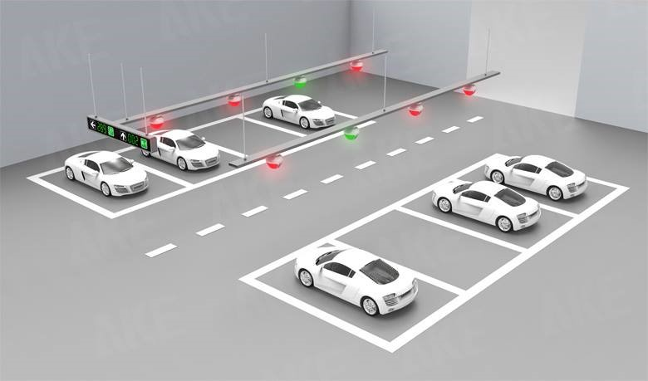
SMART PARKING
Shows the parking slot availability all the time using the dashboard
Reduces searching time for the vacant slot
Provides efficient space utilization
Reduces supervision cost
Mobile app for car parking
LoRa WAN Enabled

Slide 12
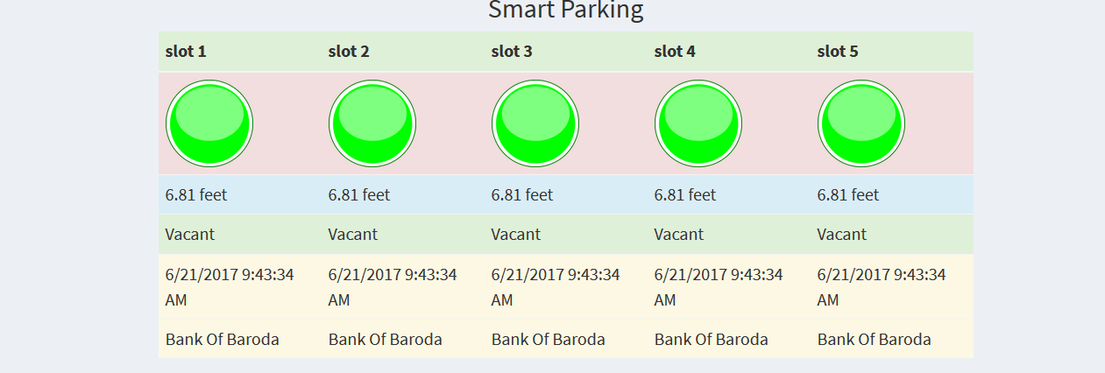
SAMPLE DATA FOR PARKING IN CITY

Slide 13
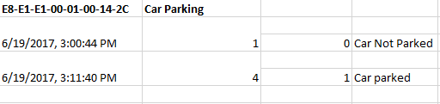
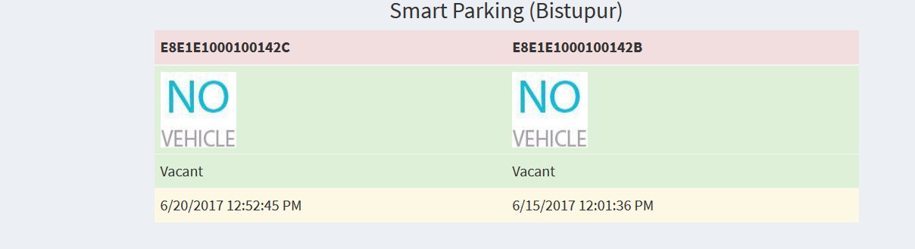
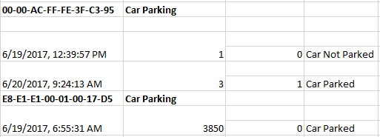
ACTUAL DATA IMPLEMENTATION
Data as received from tata communication server for different area parking ID .

Slide 14
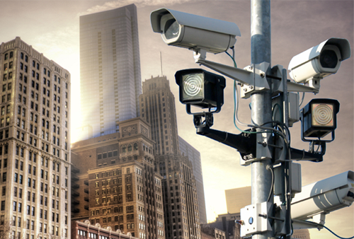
CITY SURVIELLANCE
PROPOSAL
Placement of a well networked CCTV at most of the parks and museums.
Installation of a centralized monitoring system along with the proximity sensor’s report to be analyzed on daily basis
Implementation of CCTV camera and PR sensors including intruder alarm
Placement of CCTV camera to reduce the requirement of security guards
Placement of Intrusion detection system with a buzzer to prevent theft

Slide 15
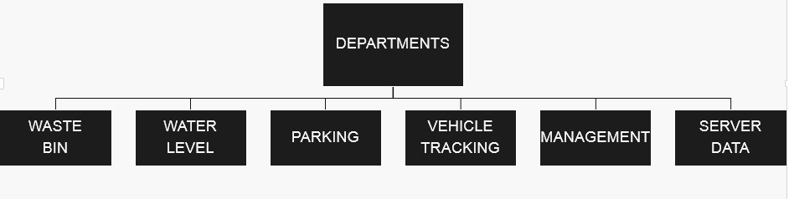
CENTRE COMMAND
A Centralized dashboard for monitoring
Water level of all the water tanks and reservoirs
Water quality of water tanks, flow of water in water treatment plants and water tanks
Dust bin level in web app/mobile app
Opening and closing of inlet and outlet valves of water tower
Data analytics that leads to better planning and efficient resource utilization

Slide 16
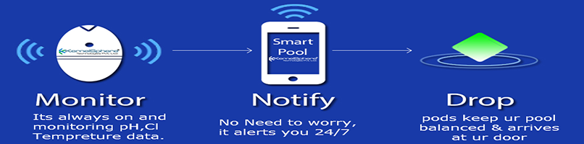
SMART POOL
BENEFITS OF IMPLEMENTATION OF SMART POOL
Notifies Chlorine, Ph and temperature level on smart phone and web application 24/7
Provides accurate sensors and reliable readings
Notifies the quantity of chloride when it is less or excess
Ensures easy monitoring of pool from anywhere
Prevents diseases due to excess chlorine
Reduces service cost and man power for maintenance

Slide 17
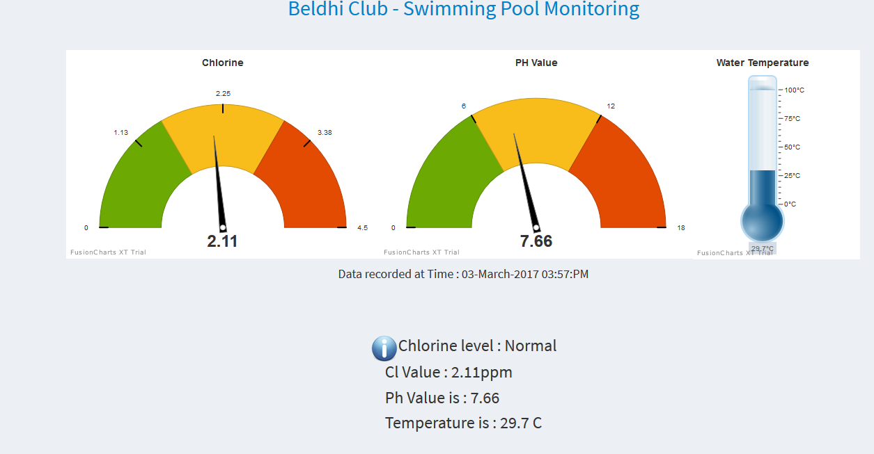
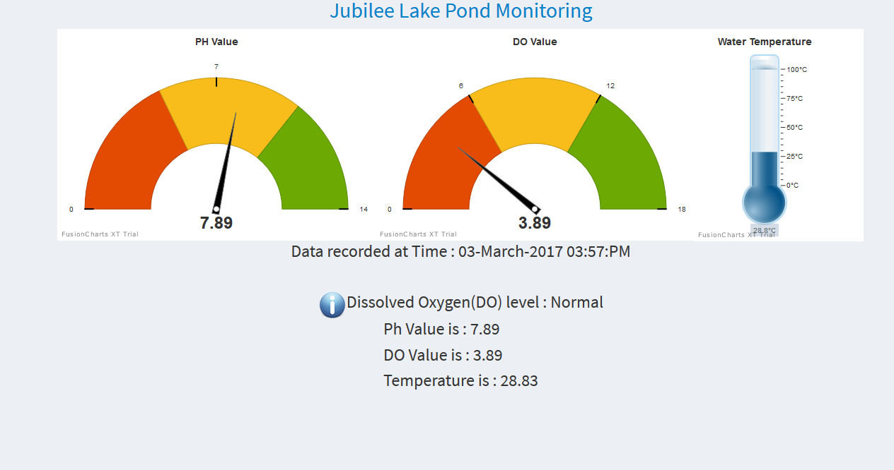
SAMPLE DATA OF POND AND POOL
IN POOL CHLORINE LEVEL , PH VALUE AND TEMPERATURE IS NOTED
IN POND DISSOLVED OXYGEN LEVEL , PH VALUE AND TEMPERATURE IS NOTED AND FOUNTAIN IS OPENED AUTOMATED IF DO LEVEL IS NOT
NORMAL , TO INCREASE AGITATION IN SURFACE WATER .

Slide 18
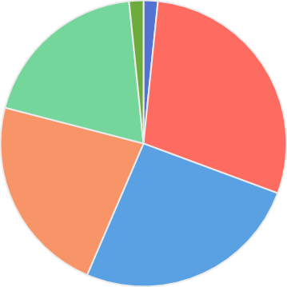
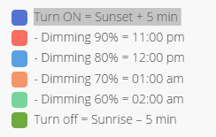
SMART STREET LIGHT
Illustration of energy saving by using light sensors and auto timers
Ensures remote monitoring and control of street light unit
Ensures remote monitoring & control of energy load consumption
Helps in dimming of illumination during off peak hours
Achieves up to 85% energy savings by dimming and smart scheduling
Ensures the provision of right amount of light whenever needed

Slide 19
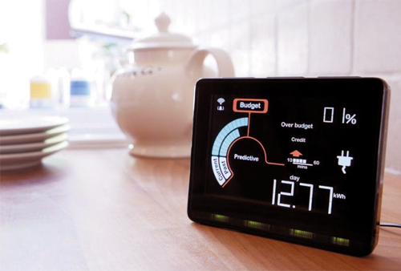
SMART ENERGY METER
BENEFITS OF IMPLEMENTATION
Helps in remote monitoring of energy meter
Reduces cost of man power for reading meters
Retrofitting of communication modem
Retrofitting of load disconnecting unit along with energy meter
Disconnects power supply remotely if bills are not paid
Ensures remote monitoring of water meter
Reduces cost of man power for reading meters
Disconnects water supply remotely if bills are not paid

Slide 20
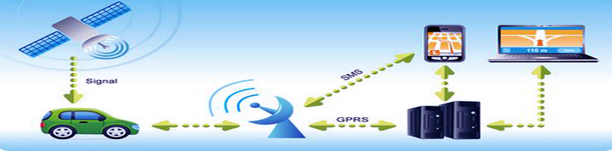
VEHICLE TRACKING SYSTEM
IDEA
Tracks 24X7 location information
Optimizes Routes
Alerts and nonfictions via SMS
Monitors vehicle’s speed
Increases productivity
Reduces operation costs
Saves money on fuel
Controls work hours
Betters customer service
Reduces insurance costs
Increases security
Improves dispatching

Slide 21
DEPLOYMENT OF VTS IN CITY
PROBLEMS PROPOSED SOLUTION
High running costs by those who speed and waste fuel
Recovery if occurrence of thefts.
Detailed information on the whereabouts of vehicles at all times and to keep an eye on employee activities.
Heavy phone bills by customers
Heavy amount of paperwork
Focussing upon those drivers it is possible to not only reduce fuel and maintenance bills, but to also reduce insurance premiums.
Some insurance companies will give recovery if thefts do occur.
Productivity of workers can be increased by being able to keep track of lunch hours, exposing unauthorised stops and breaks and by evaluating the overtime requests of workers.
Vehicle tracking systems will vastly reduce your phone bills as it is no longer a necessity to constantly call employees to find their location.
Increase the accuracy of your records.

Slide 22
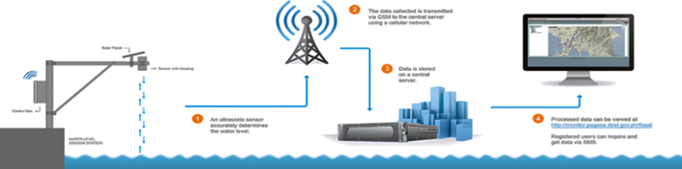
WATER TOWER MANAGEMENT
IMPLEMENTATION
Ensures live monitoring of water level in water tanks
Automatically turns on and turns off the valves coming from water treatment plant to water tower
Sets time automatically for opening and closing the outlet valves going to consumer houses
Monitors water quality including chlorine, turbidity, PH level and conductivity
Makes water tower WI-FI enabled

Slide 23
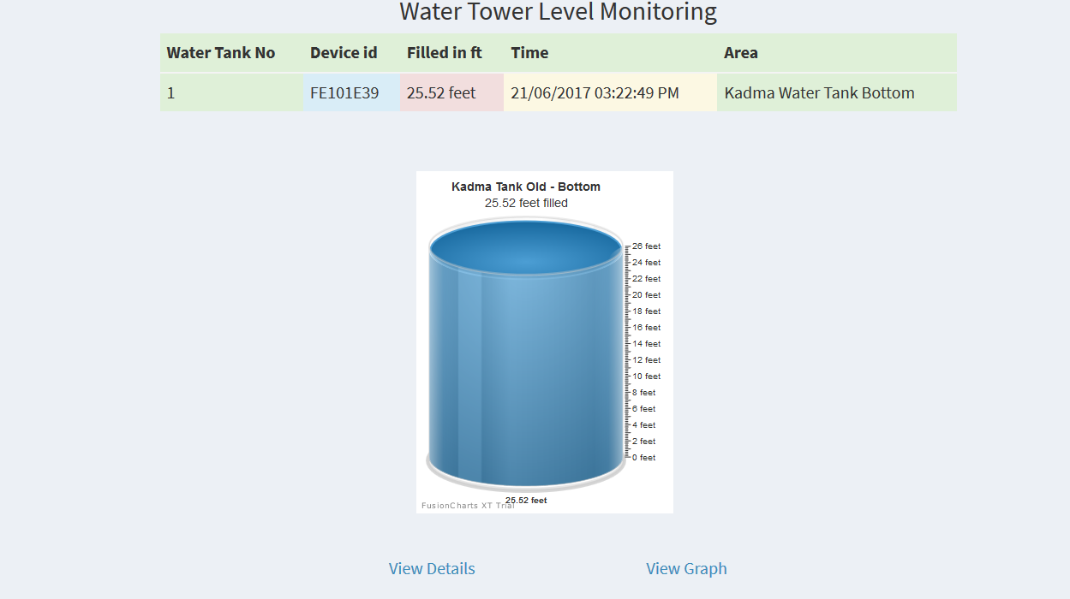
SAMPLE OF CITY IMPLEMENTATION OF WATER MANAGEMENT
Gives live updates of water level of each tank
Ensures live quality monitoring of water tanks and water reservoir
Detects Motor’s fault by checking motor vibration, motor winding temperature
Minimizes manual intervention due to automated valve control
Provides data analytics to lead better planning
Saves water and electricity by 30 %
Reduces maintenance and labor cost
Ensures live monitoring of flow of water in water treatment plant
Auto chemical (chlorine) doping in water treatment plant

Slide 24
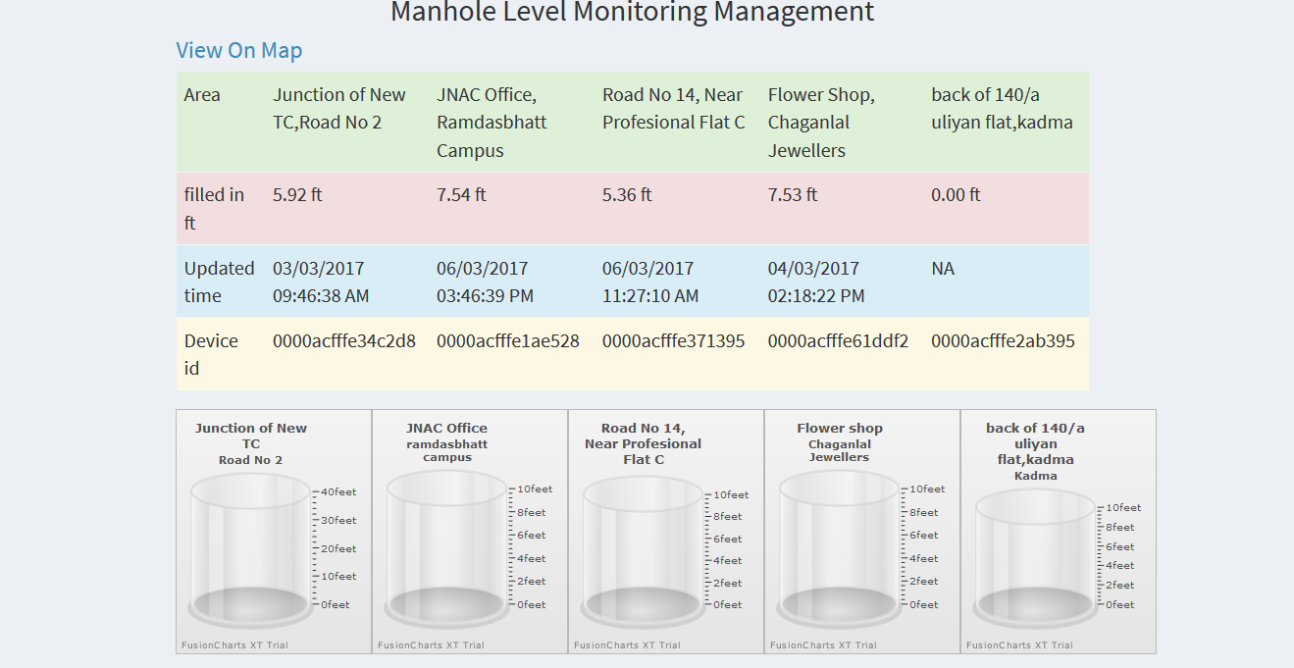
MANHOLE LEVEL MONITORING MANAGEMENT
SAMPLE CITY DATA AS ON IMPLEMENTATION

Slide 25
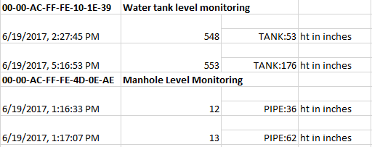
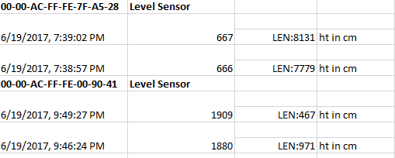
ACTUAL DATA RECEIVED IN LEVEL SENSORS
sample real data of water tank level monitoring

Slide 26

WORK FORCE TRACKING
IDEA / PROPOSAL
LoRa WAN and GPS antennas ensures receiving and transmitting accurate position of worker
Alerts and provides info via SMS/email
Ensures real time location and tracking of workers through smart wearable devices
Leads to better planning and efficient resource utilization by Data analytics
Helps improve work force efficiency
Helps reduce the supervision cost by 30%

Slide 27
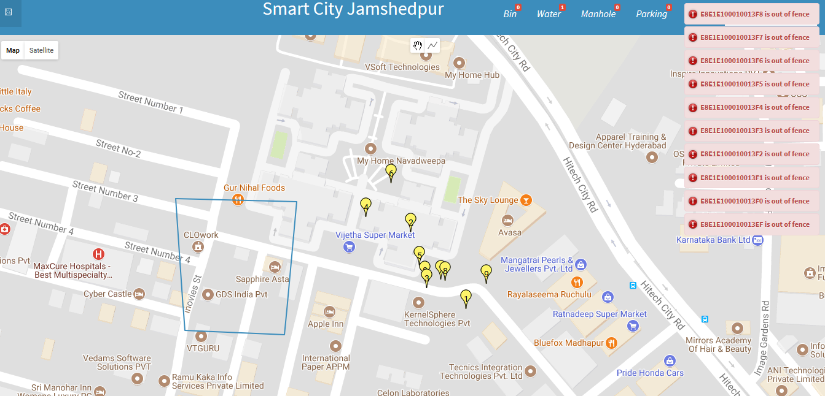
SAMPLE DATA OF WORK FORCE TRACKING

Slide 28
WCCD ISO 37120 DATA
ANALYSIS
Series 1- pune 2-Jamshedpur 3-london

Slide 31
THANK YOU

